Slide 1
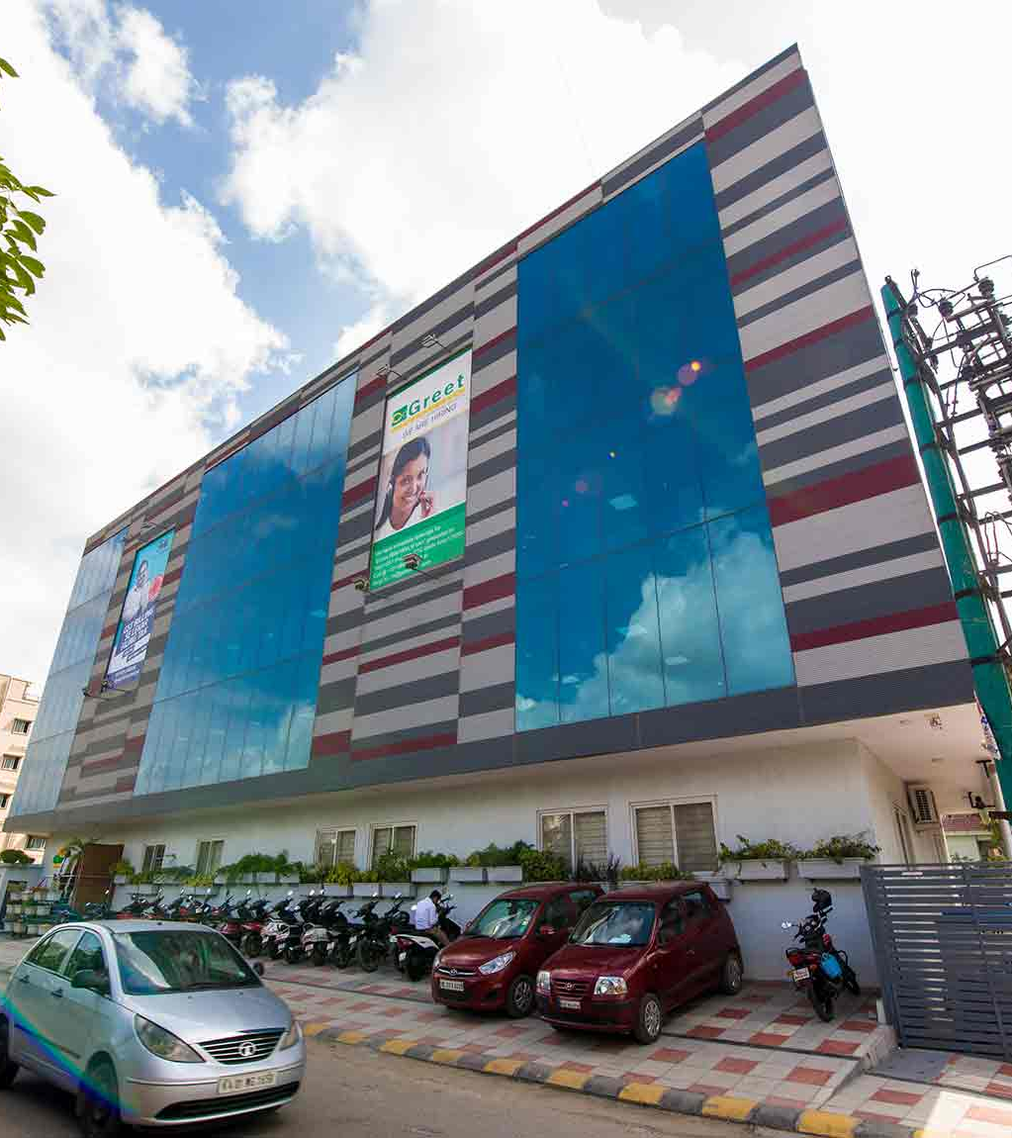
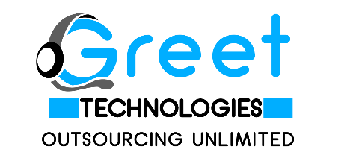
Leading Provider of Value-Added Customer Support / Data entry Services

Slide 2
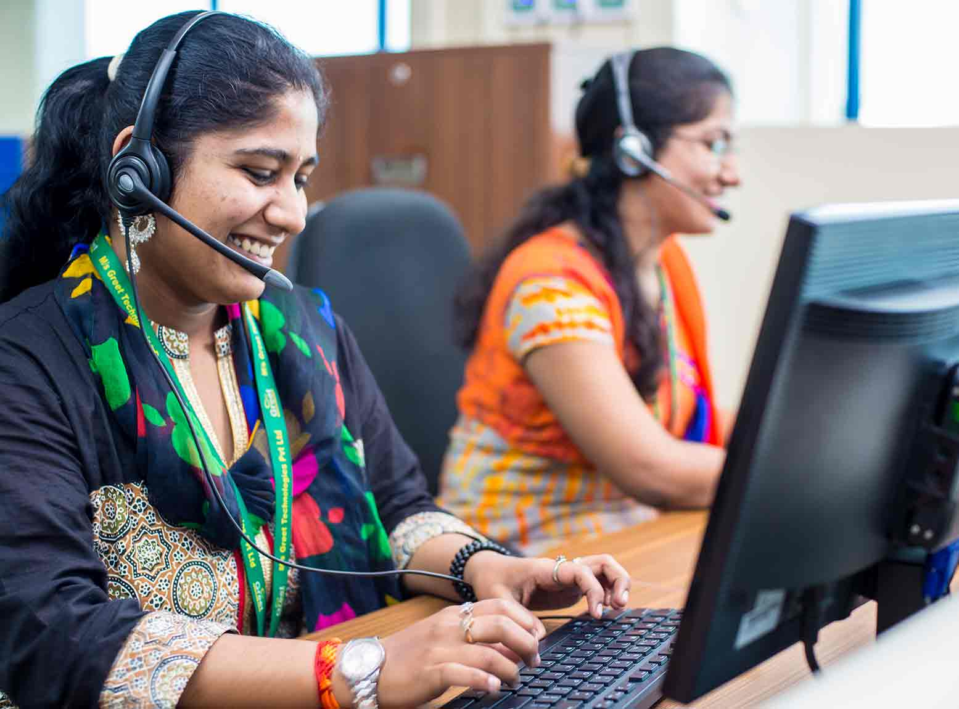
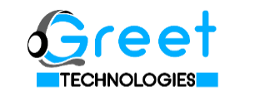
We’ve been
bridging the GAP between your customers’ support related needs and building Customer Delight.
We provide you a highly cost-effective, flexible and scalable Customer Support/Data entry set up
http://www.greettech.com

Slide 3

Proven Expertise & Experience
Thousands of man hours of experience and expertise
Handling thousands of calls/emails/chat daily as well as well as Data entry work
Customers across Asia, The Middle East, Europe and Africa
http://www.greettech.com

Slide 4
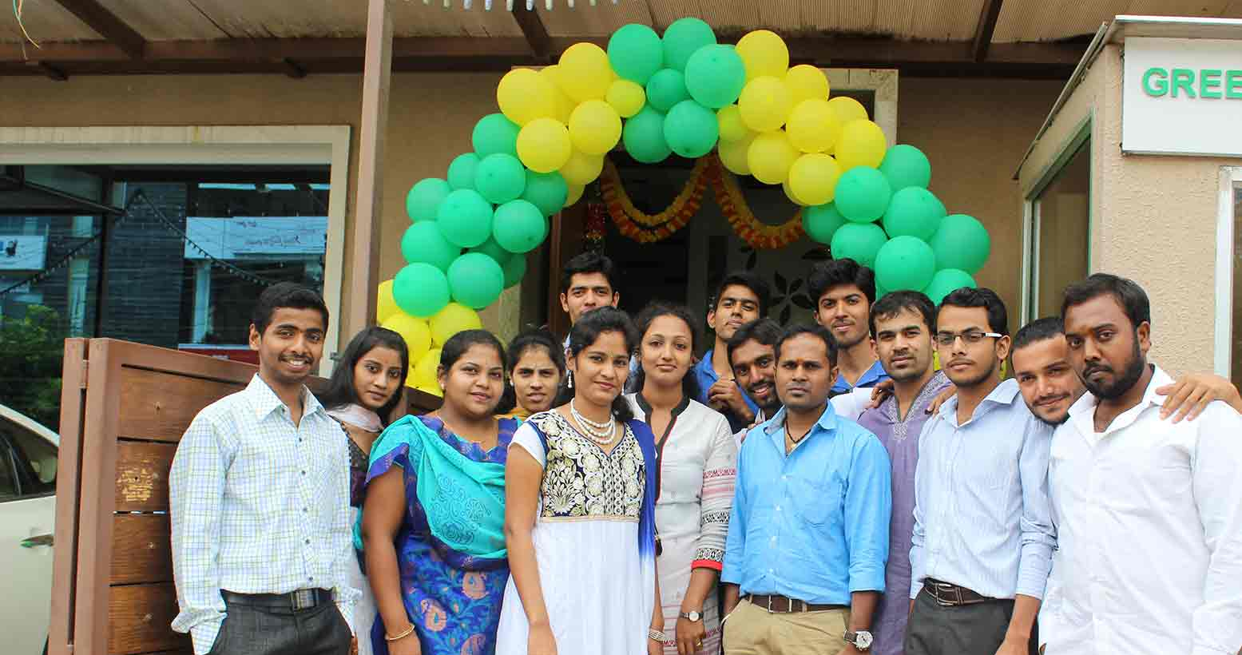
Our Team
Vastly experienced and highly trained Support professionals
Operate from a highly secure and hi-tech facility
http://www.greettech.com

Slide 5
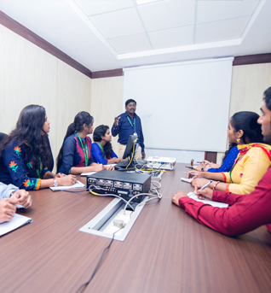
Our Approach
Offer customers immense flexibility
Customised services
Total quality assurances
Operate in real time
Benefits from Hour 1
http://www.greettech.com

Slide 6
Domain Expertise and Competency
Process
Competencies
Industry
Expertise
Service
Channels
Transaction Processing
Mailroom & Scanning
Data entry
Account Maintenance
Application Processing
Fulfillment Services
Image Correction
Outbound Voice
Outbound Voice
Telemarketing
Lead Generation
Database Building / Cleaning
Soft Collections
Welcome Calls
Provider Calls
Inbound Voice
Customer Care
Collections
Technical Help Desk
Service Provisioning
Product Support
Cross-sell & Up-Sell
Directory Enquiry
Member Calls
Contact
Voice
Email
Chat
Transaction
Processing
Blended
Voice & Email
Voice & Transaction
http://www.greettech.com

Slide 7
Quality Control System
http://www.greettech.com

Slide 8
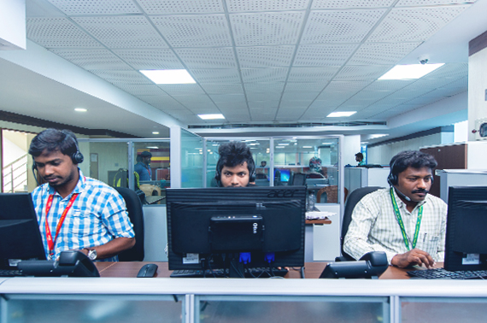
Key
Differentiators
We provide our customers world-class support without additional manpower or technology
No infrastructure pre-requisites
Commence operations, literally, from Hour 1.
Infrastructure fully geared for ‘immediate deployment’

Slide 9
World Class IT Environment
http://www.greettech.com

Slide 10
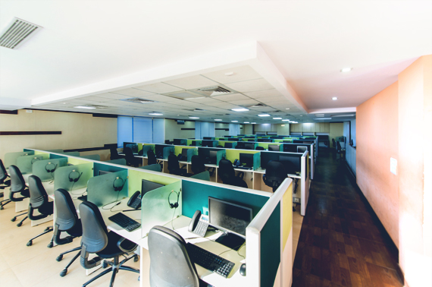
Latest Technology
Backup
Latest technology environment… ensuring 100% reliability, flexibility and security
IPLC links via diverse and redundant routes
Redundant domestic loop
VPN connectivity for back up
Back-up for all critical equipments
Availability of captive power with redundancy
Round-the-clock availability of technical services team
http://www.greettech.com

Slide 11
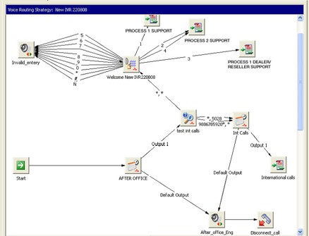
Sample
Workflow
Workflow can be created and adapted to suit individual client requirements
http://www.greettech.com

Slide 12
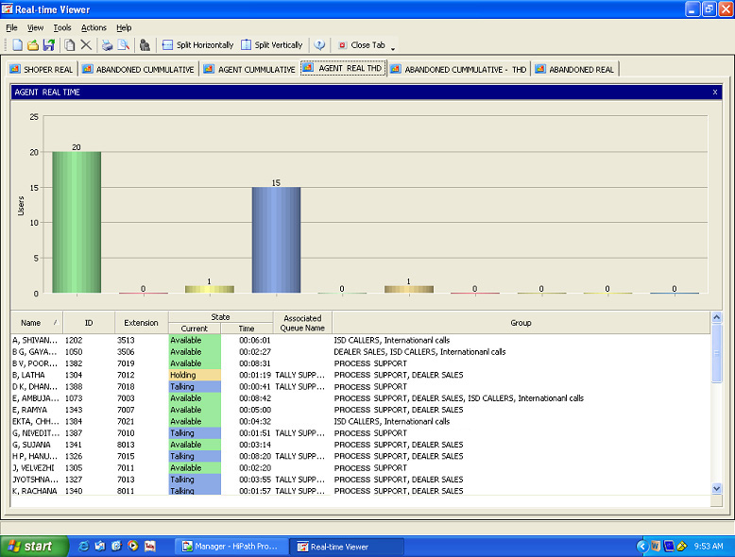
Real-time Agent Performance
Analyst
Workflow can be created and adapted to suit individual client requirements
Real-time Monitoring capability
Real-time and Agent History Analysis
Bird’s eye-view of agents on call / call status and Queuing Status
http://www.greettech.com

Slide 13
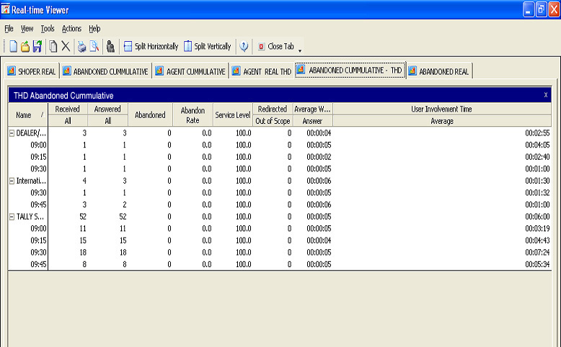
Sample Call
Analysis –
Abandoned Calls
Call details, including receipt, waiting time, abandoned calls and user involvement time are studied
http://www.greettech.com

Slide 14
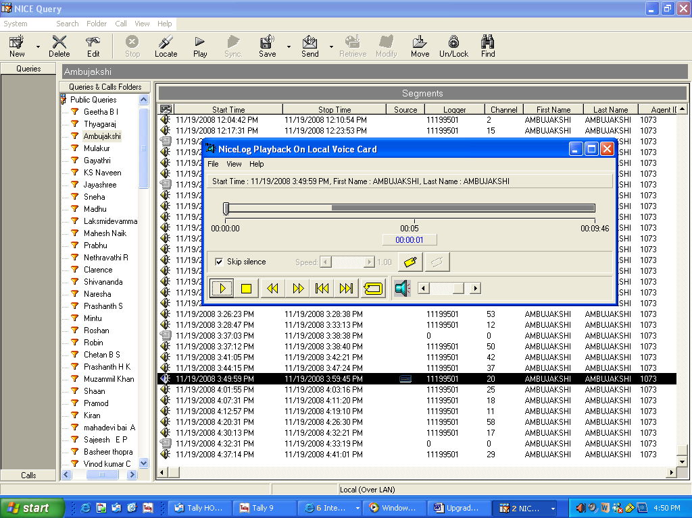
Quality Control
Screenshot –
Call Play-Back
Demo
Workflow can be created and adapted to suit individual client requirements
All Agent Calls are recorded and can be played back for Quality Checks and Control Measures
http://www.greettech.com

Slide 15
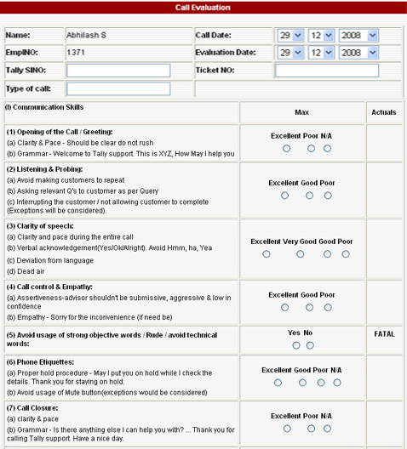
Quality Control -
Call Evaluation
Criteria
Workflow can be created and adapted to suit individual client requirements
Various parameters that have an impact on Quality in Customer Support are analyzed and evaluated for maximum customer satisfaction.
http://www.greettech.com

Slide 16
To Offer World Class Support to your Customers as well as any kind of Data entry work:
Greet Technologies Pvt Ltd.
327-328, 5th main Service Road, 6th Sector , HSR Layout,
Bangalore – 560102. India.
Phone: +91-80-225543000
Email: profit@greettech.com , Website: www.greettech.com
http://www.greettech.com

